Slide 1

FLIXTERS
Movie Recommender Systems

Slide 2








MEET THE TEAM
Bulelani
Lizette
Nelisiwe
Ridha
Noluthando
Nompilo
Sizwe

Slide 3
THE PROBLEM
In today’s technology driven world, recommender systems are socially and economically critical for ensuring that individuals can make appropriate choices surrounding the content they engage with on a daily basis.
Providing an accurate and robust solution to this challenge has immense economic potential, with users of the system being exposed to content they would like to view or purchase - generating revenue and platform affinity.

Slide 4
THE SOLUTION
We developed a movie recommendation algorithm that is capable of accurately predicting how a user will rate a movie, based on their historical preferences.

Slide 5
FEATURES
User Ratings
Movies
Genres
Directors
Exploratory
Data
Analysis

Slide 6
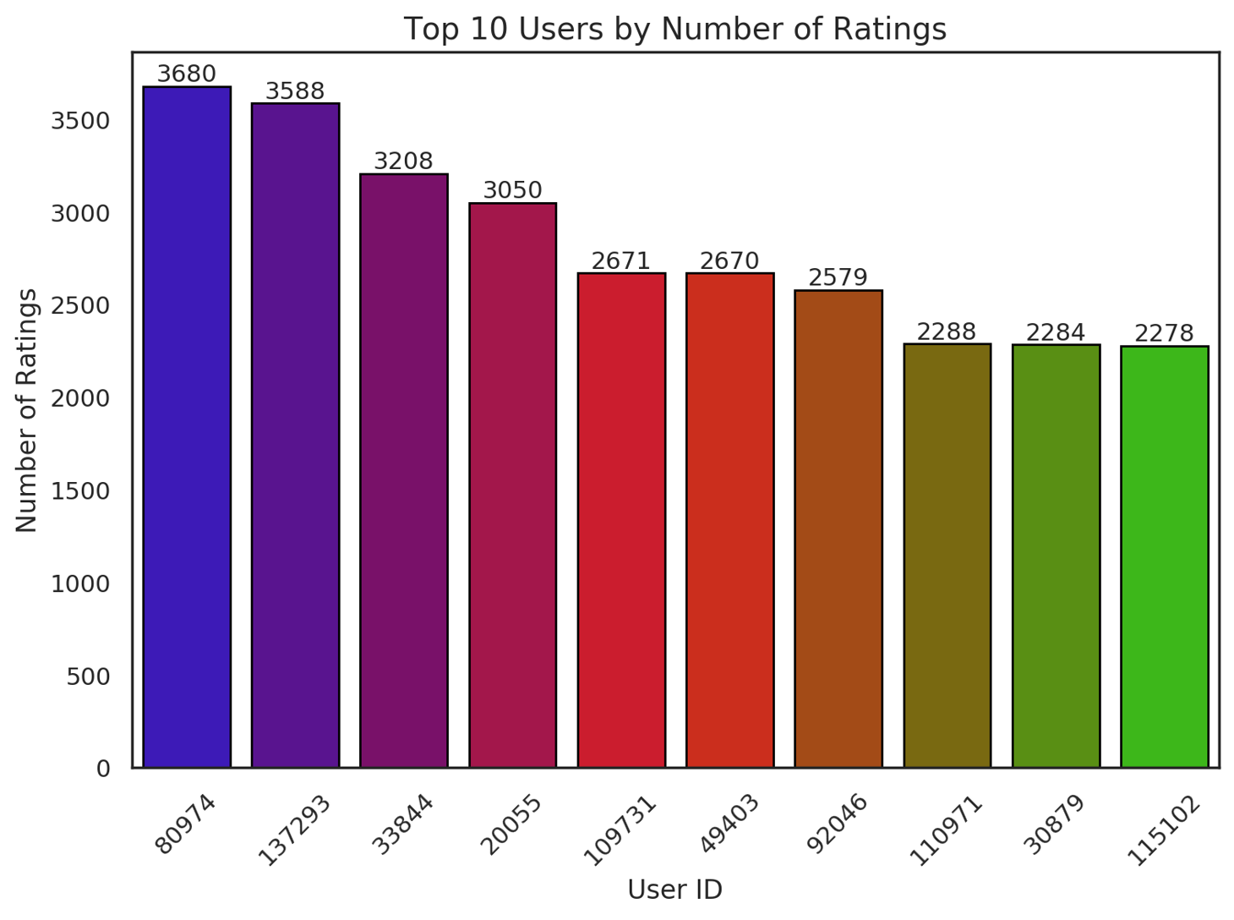
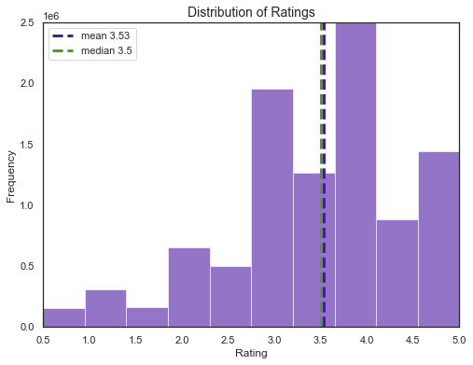
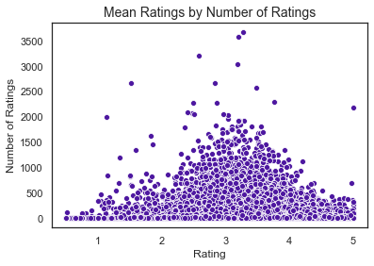
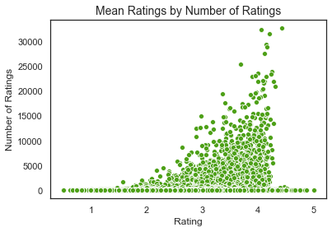
USERS

Slide 7
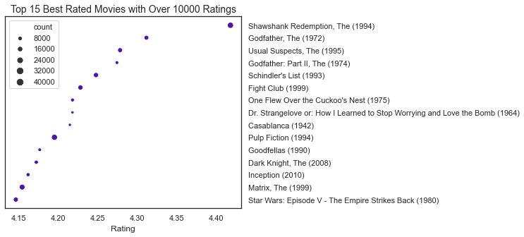
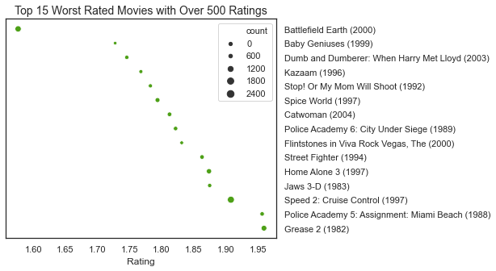
MOVIES

Slide 8
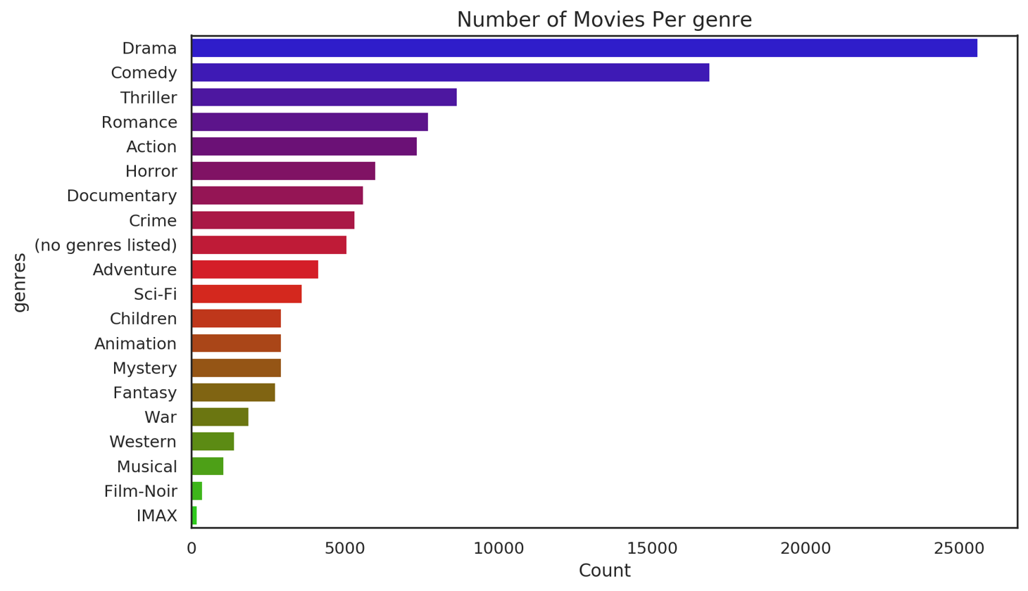
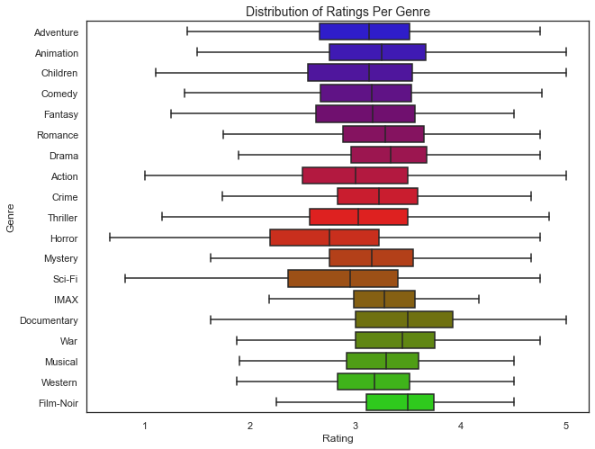
GENRES

Slide 9
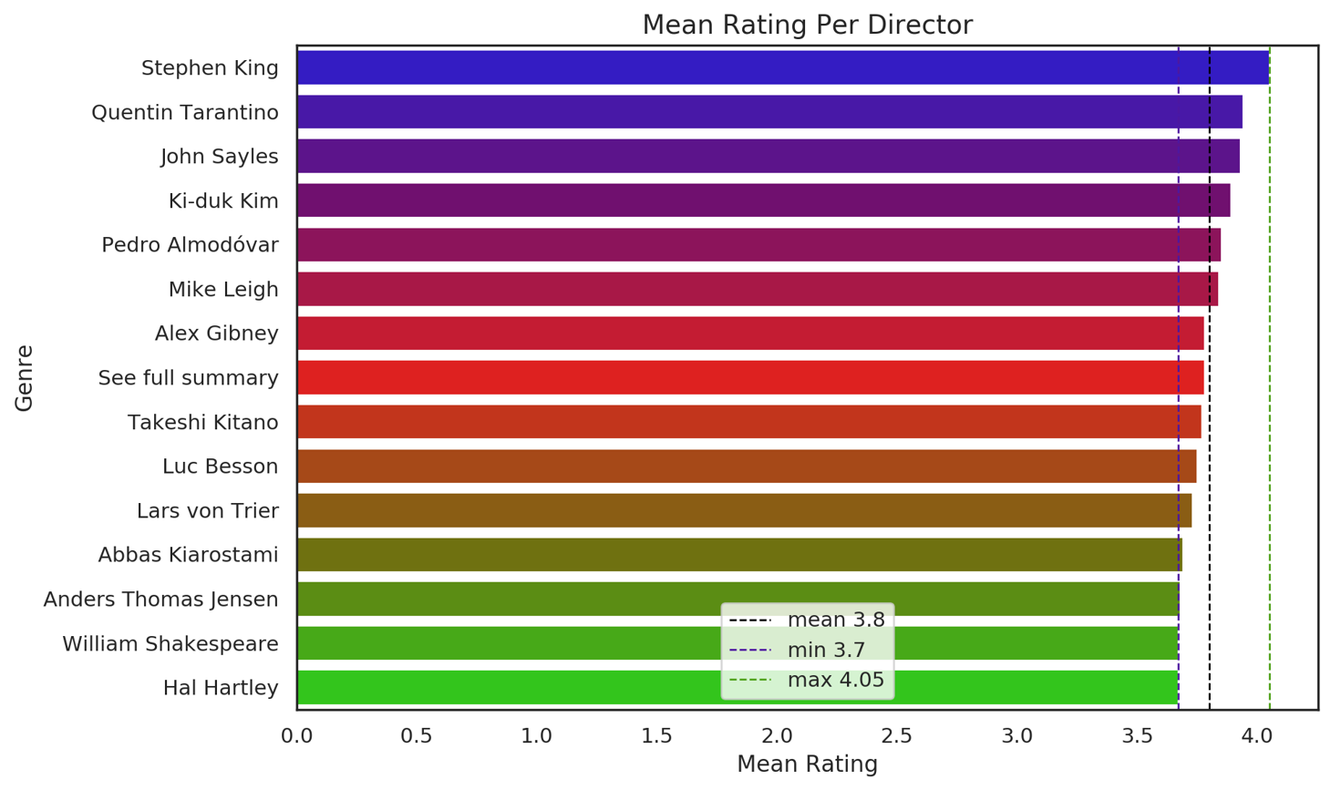
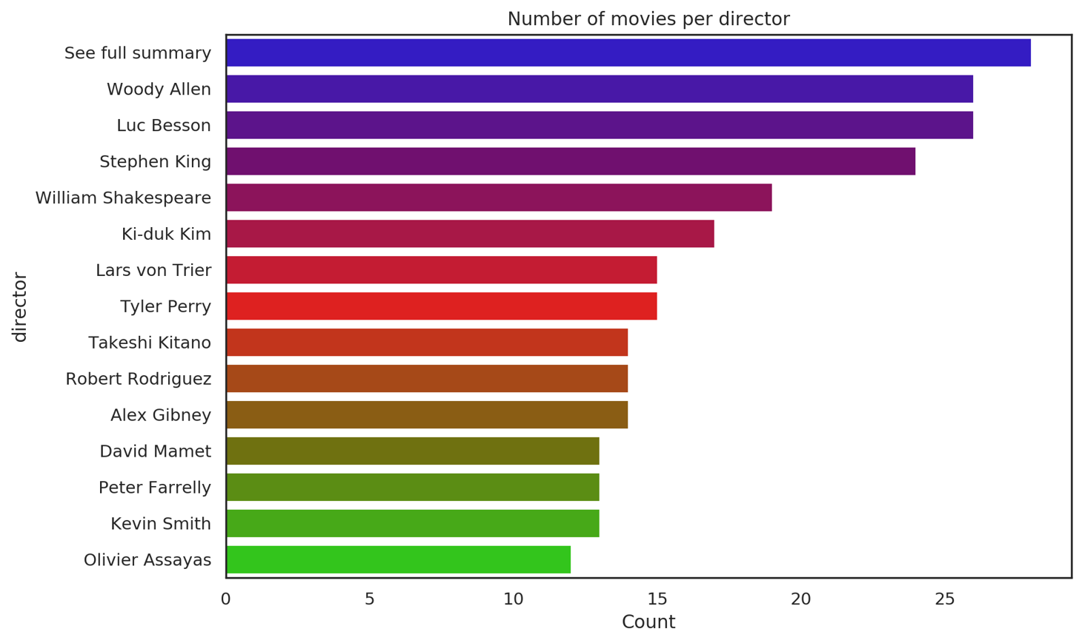
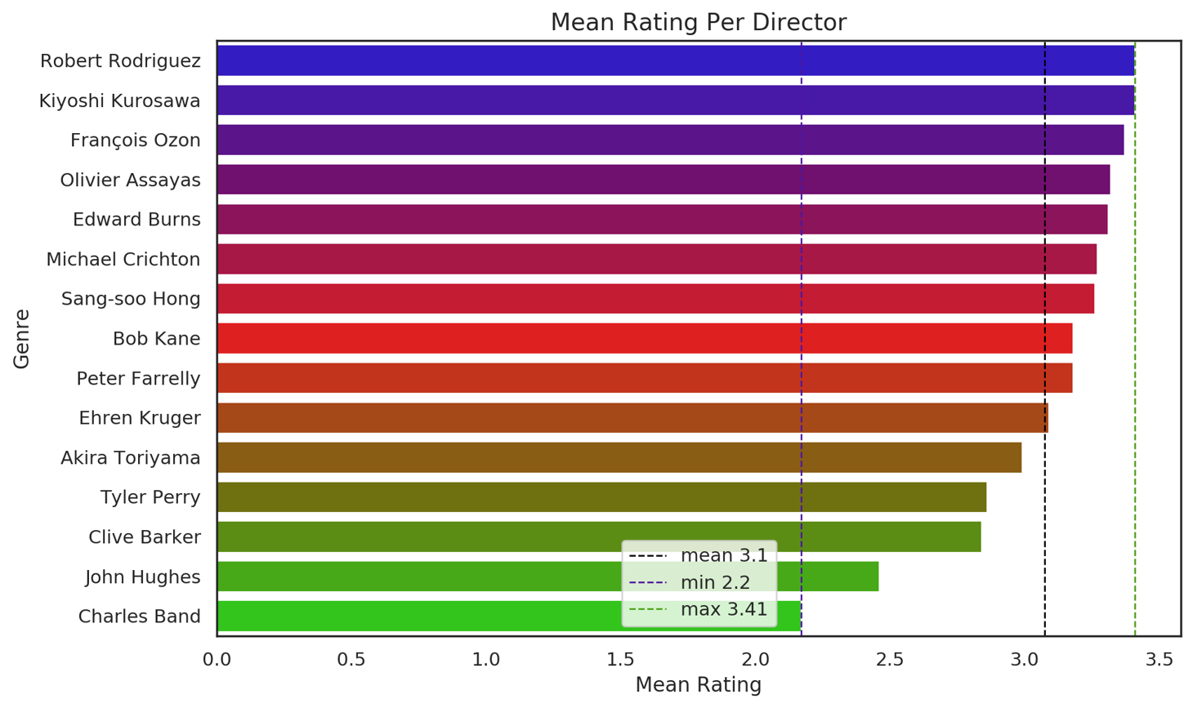
DIRECTORS

Slide 10
FEATURES
Exploratory
Data
Analysis
Content-based
Filtering
Collaborative
Filtering

Slide 11
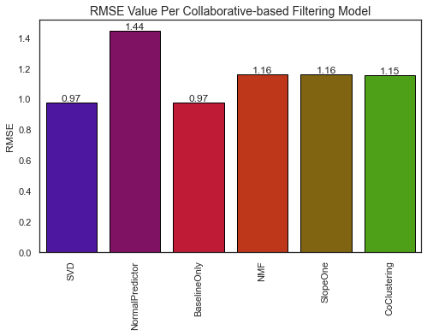
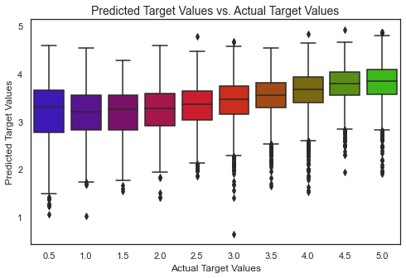
RMSE = 0,786

Slide 12
FEATURES
Exploratory
Data
Analysis
Content-based
Filtering
Collaborative
Filtering
Top10 Predictions

Slide 13
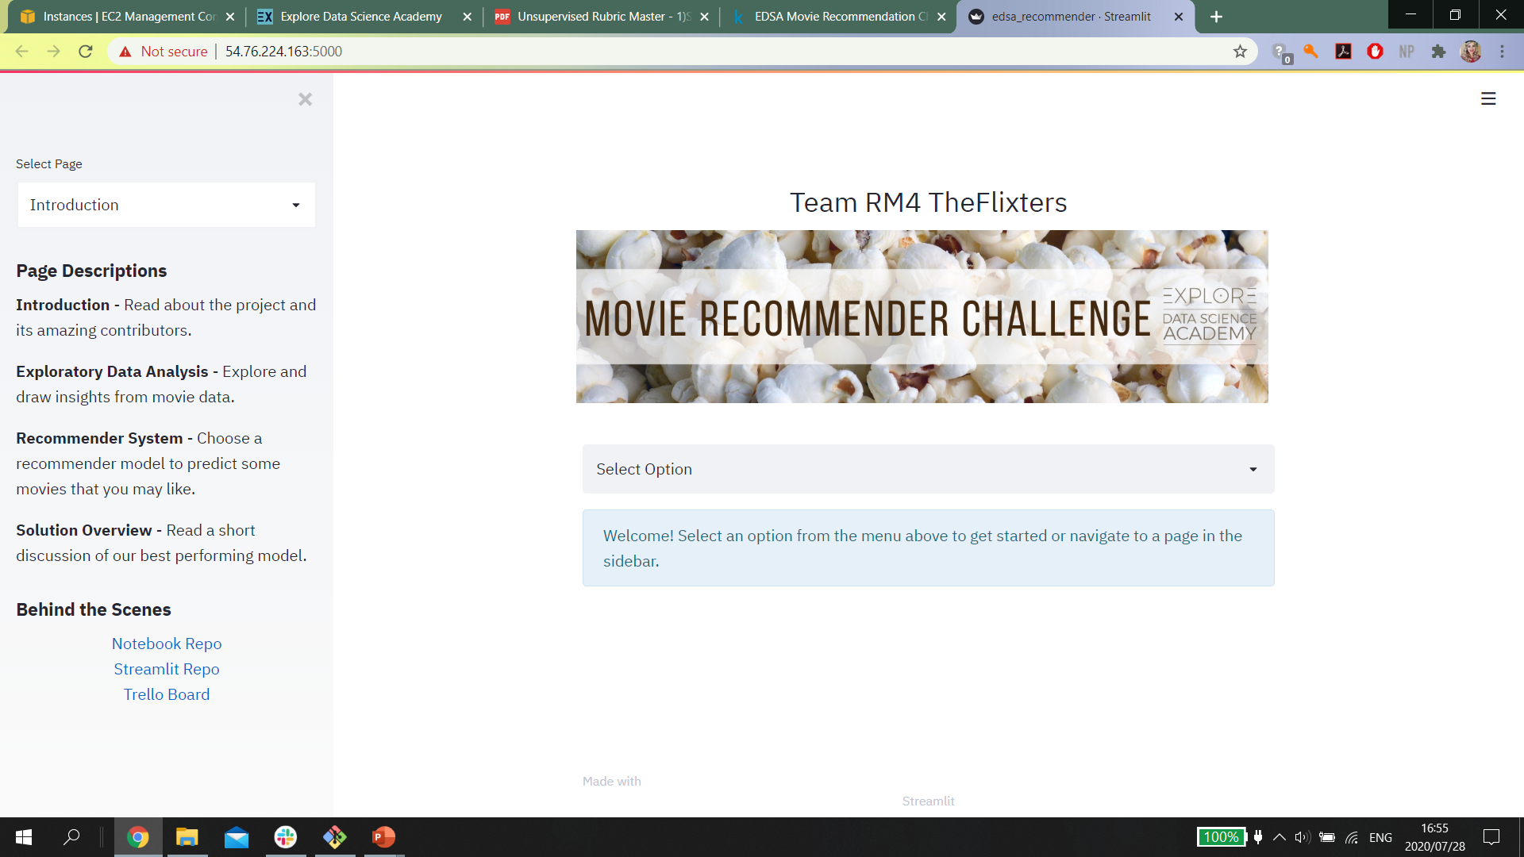
STREAMLIT
WEB APP
Recommend movies and explore data insights with our user-friendly app
APP FRONT PAGE SCREENSHOT

Slide 14
INTRODUCTION
Project Overview | Contributors

Slide 15
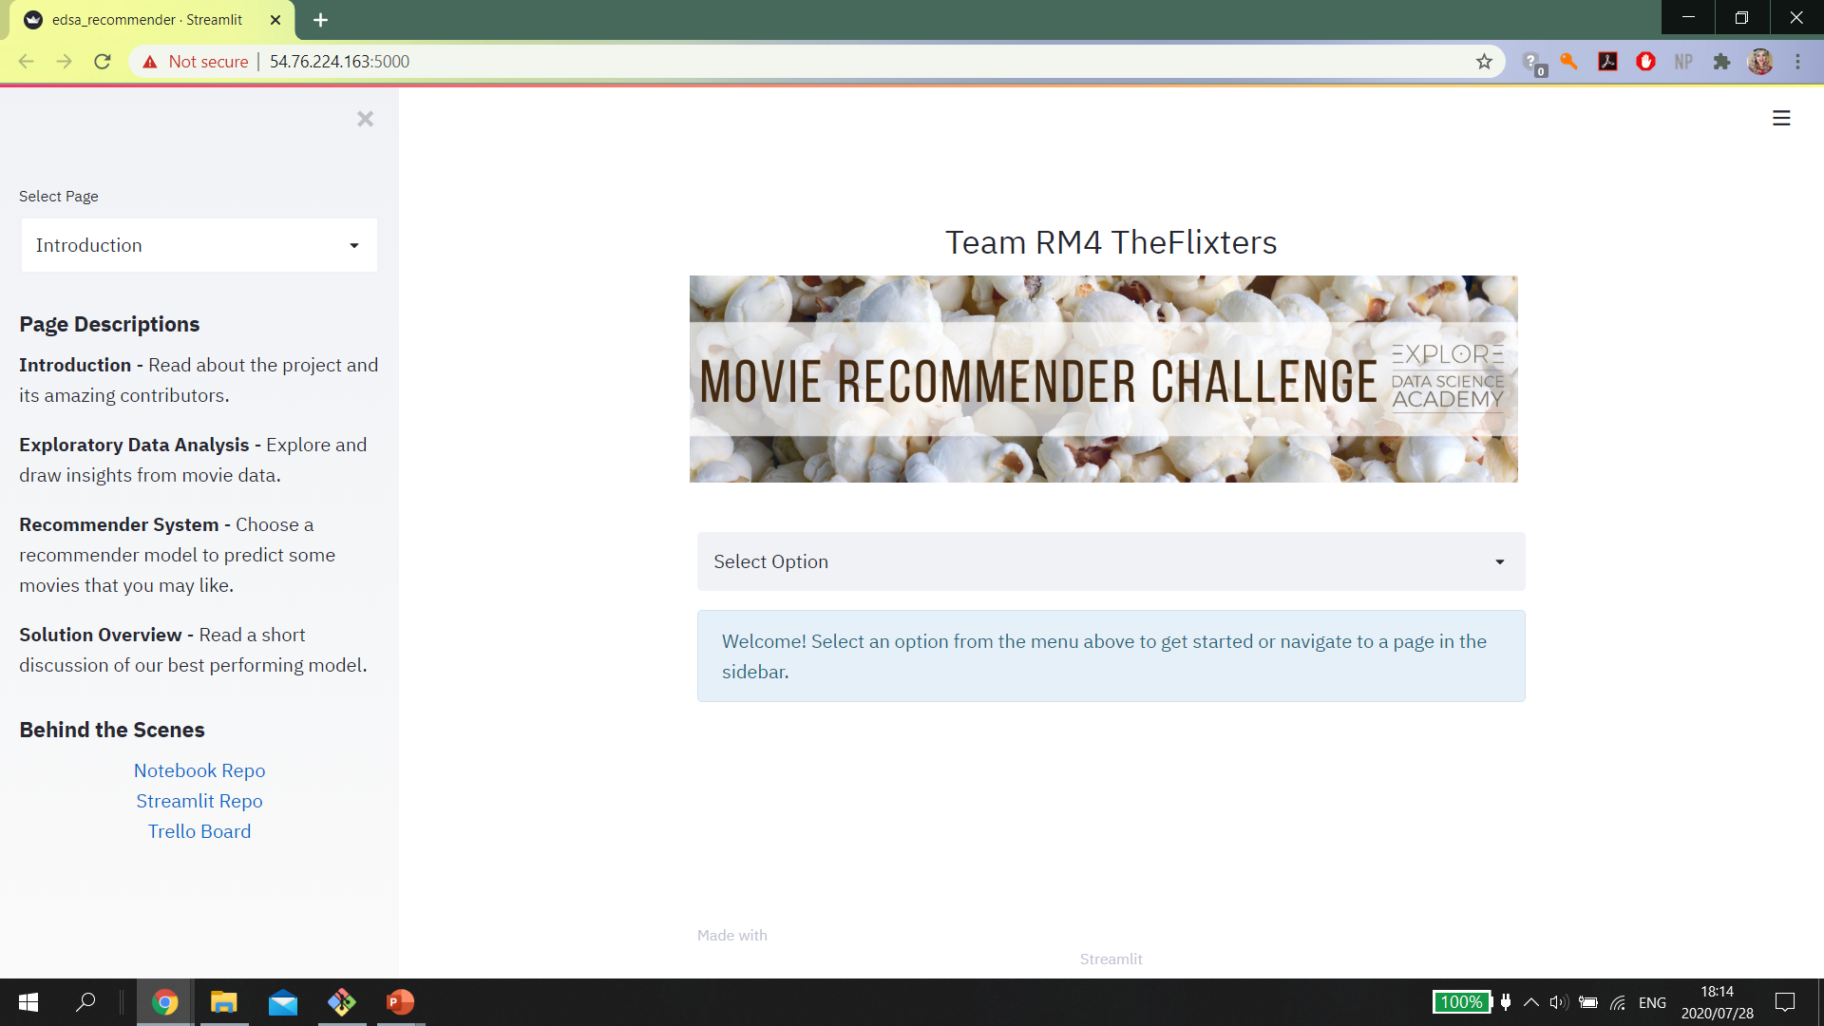

Slide 16
EXPLORATORY DATA ANALYSIS
Insights On Movie Data

Slide 17
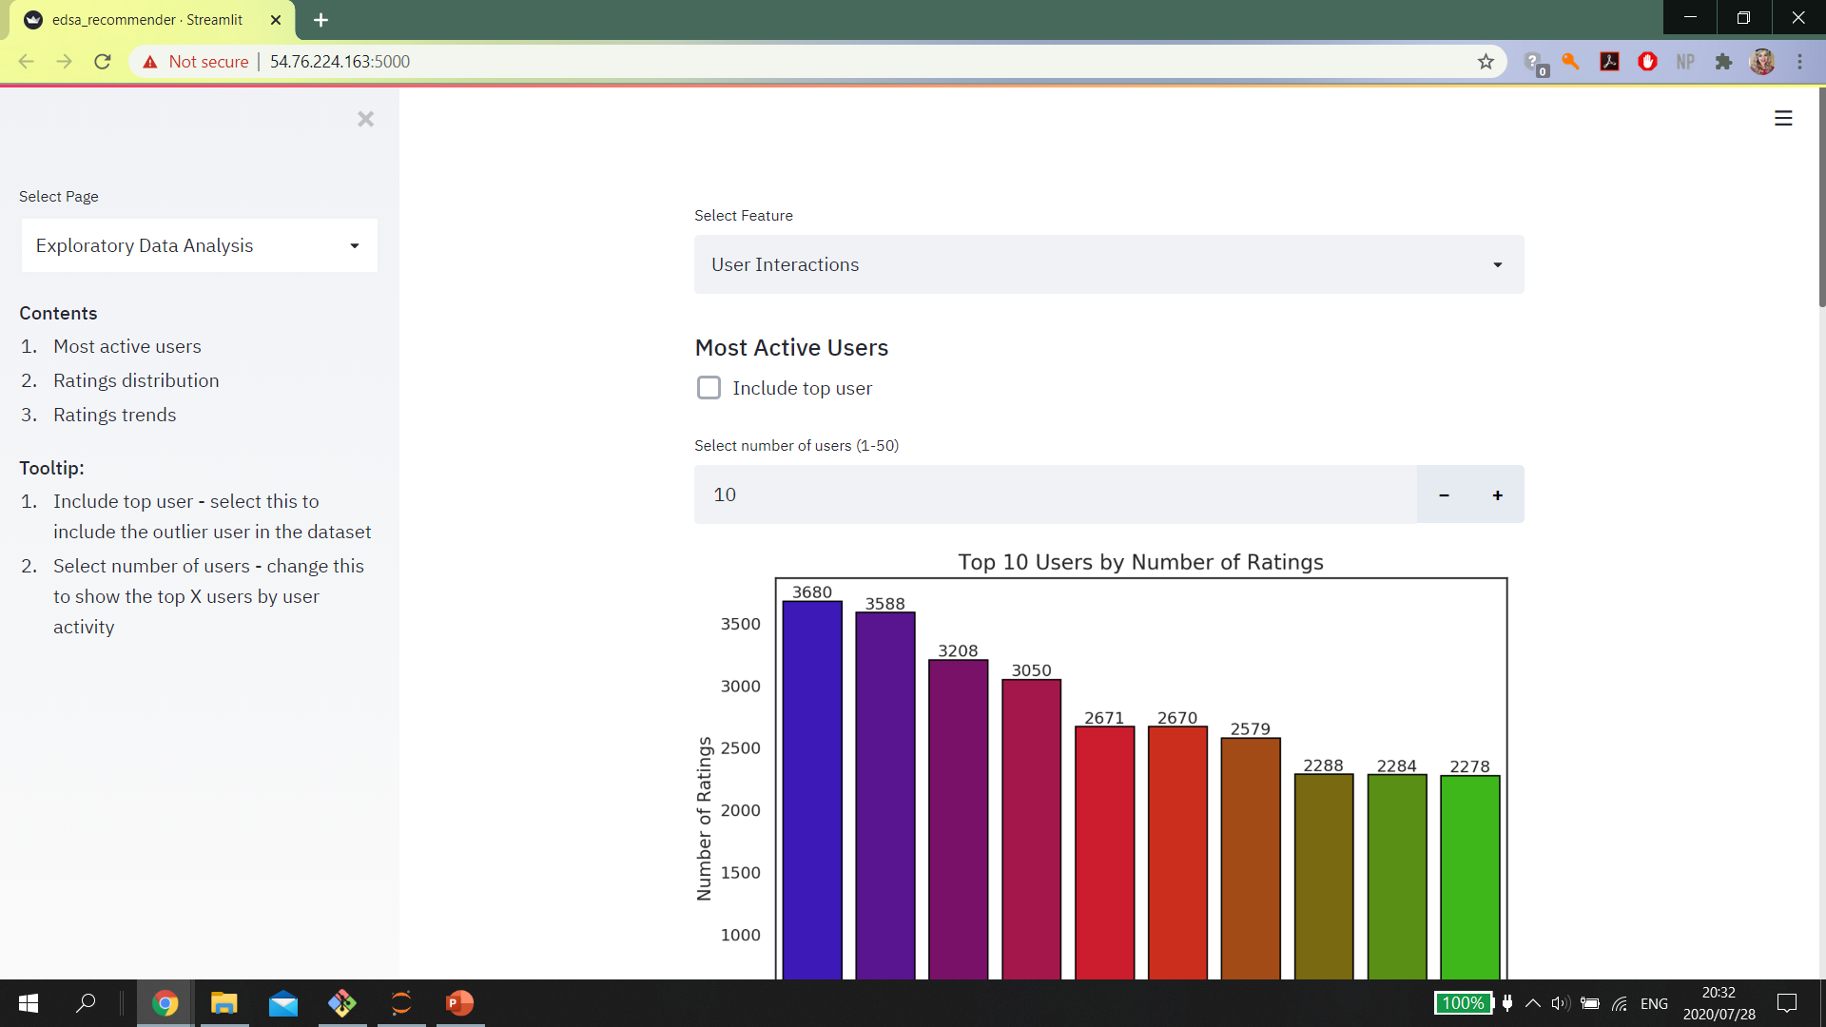

Slide 18
RECOMMENDER SYSTEM
Content-based & Collaborative

Slide 19
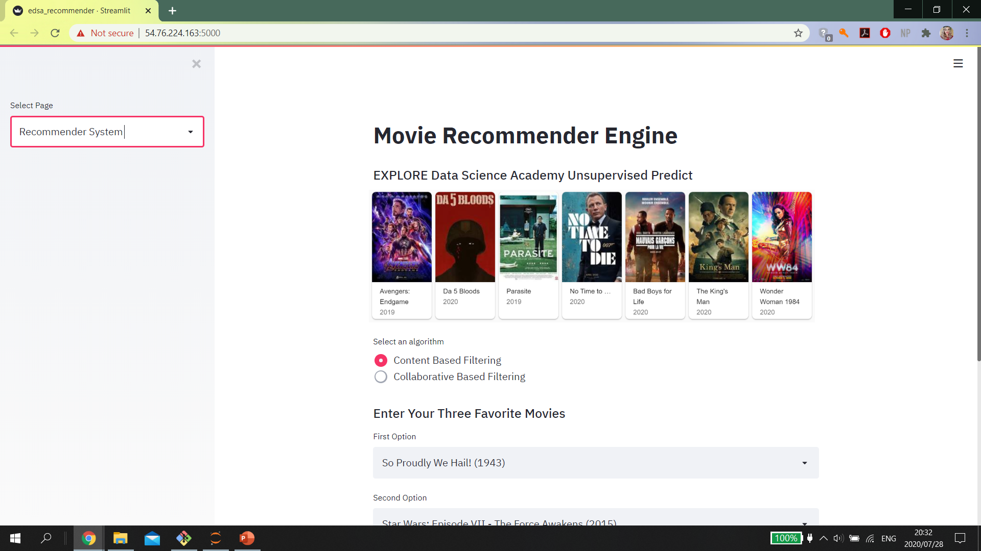

Slide 20
SOLUTION OVERVIEW
Model Summary

Slide 21
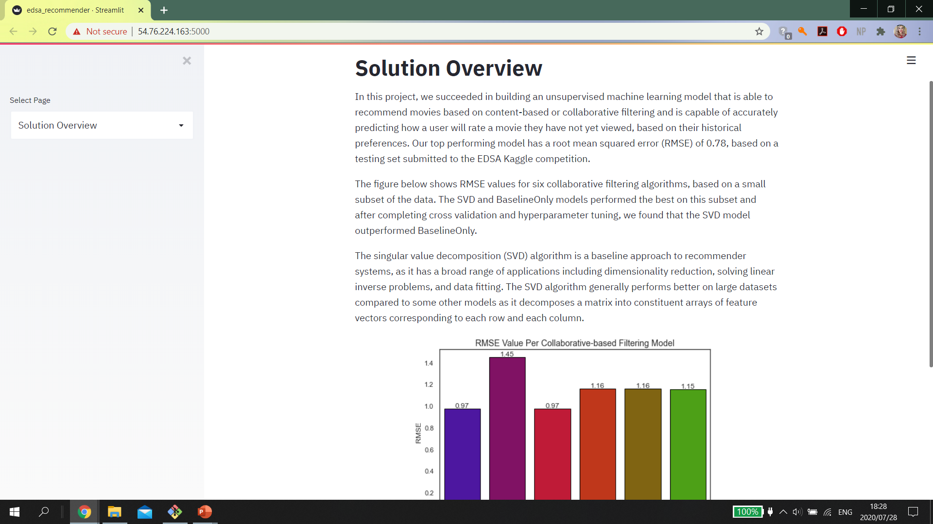
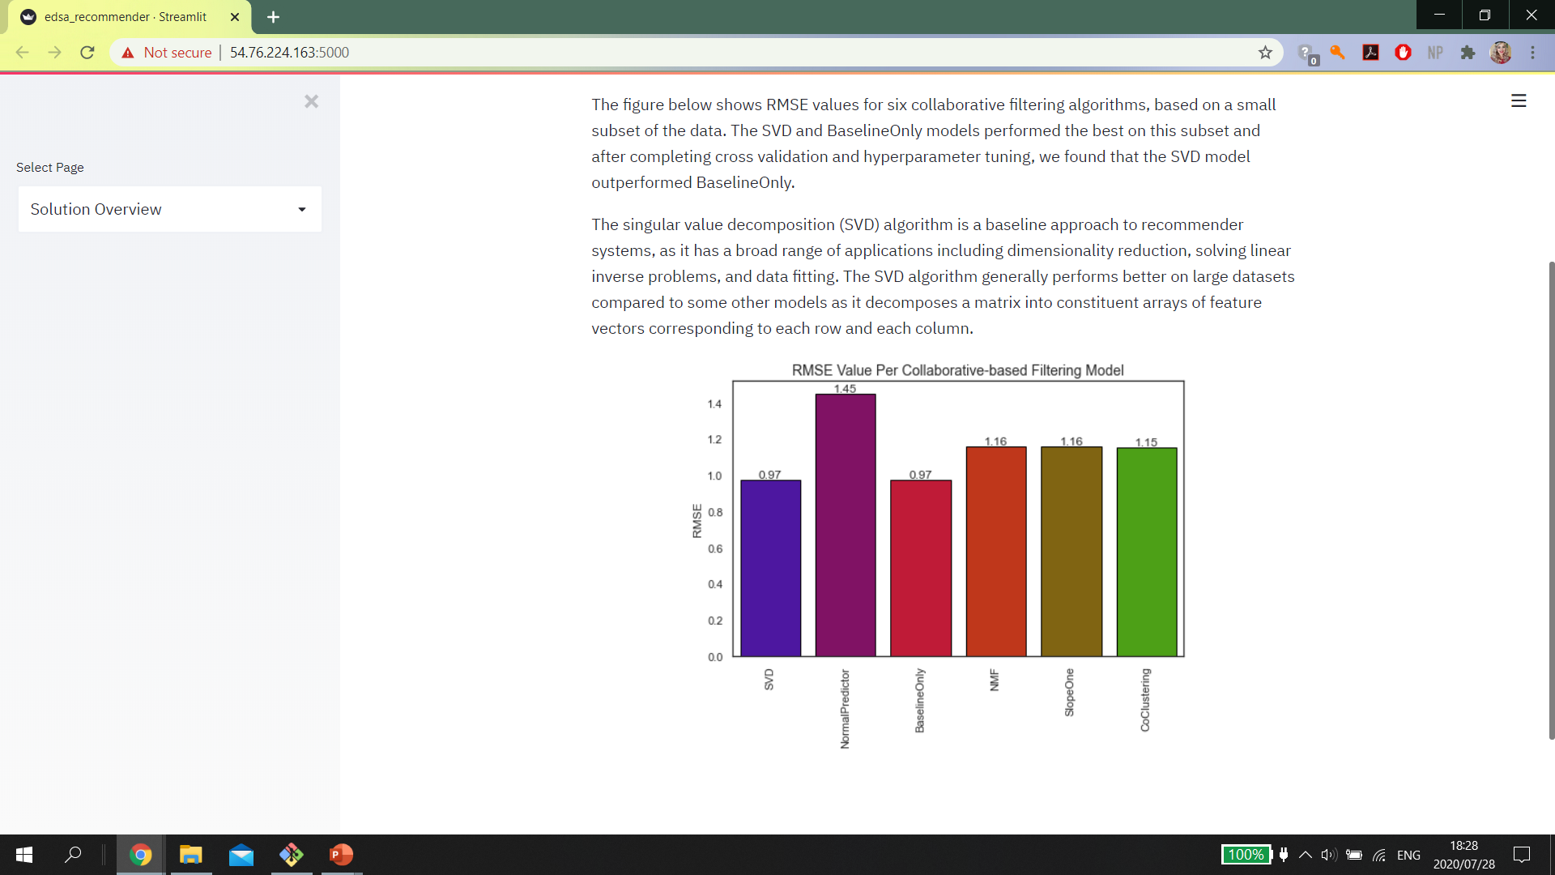

Slide 22
COMET
Experiment Logs

Slide 23
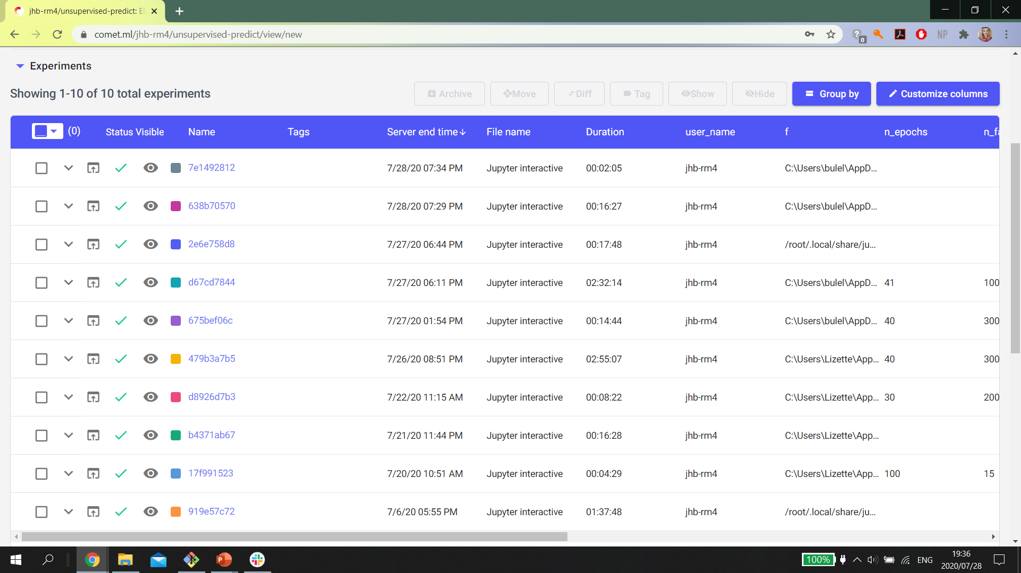

Slide 24

Thank You!
Any Questions?

